Slide 1
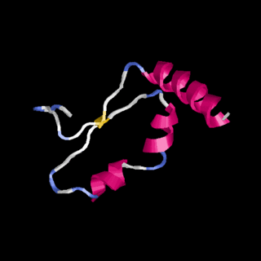
February 2021
Science of Living System
BS20001 (2-0-0)
Proteins
Q
M
S
R
A
L
T
V
K
Dibyendu Samanta
School of Bioscience
Email: dibyendu.samanta@iitkgp.ac.in
Tel: 03222-260295

Slide 2
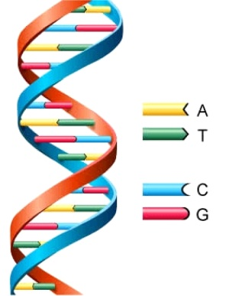
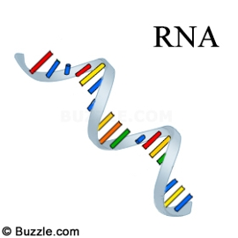
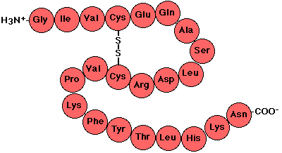
Central Dogma of life
DNA: Storage Medium
Polymer of nucleotides
CCTGAGCCAACTATTGATGAA
RNA: Transmission Medium
Polymer of nucleotides
CCUGAGCCAACUAUUGAUGAA
Protein: Molecular Machines
Polymer of amino acids
PEPTIDE

Slide 3
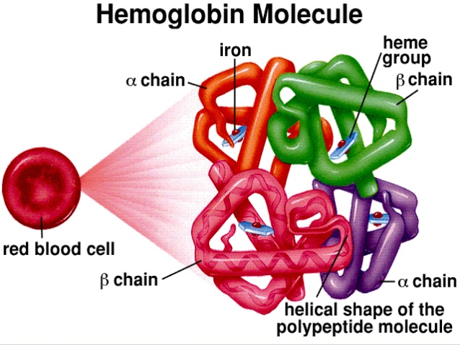
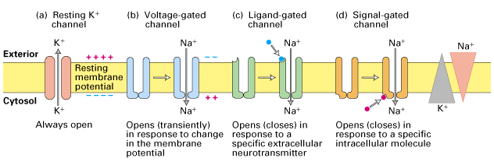
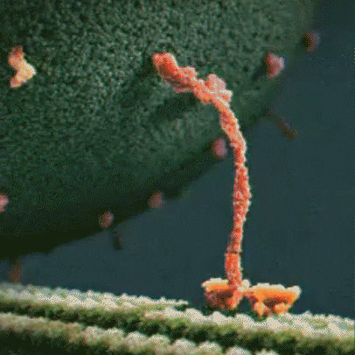
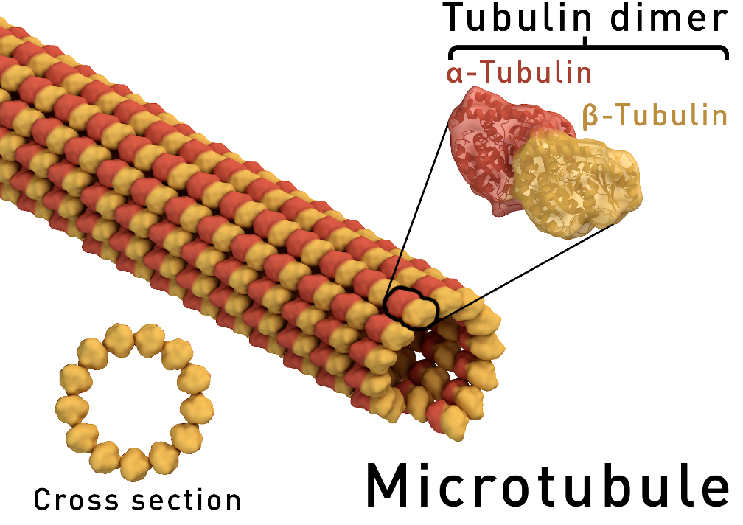
Proteins come in various shapes and sizes

Slide 4
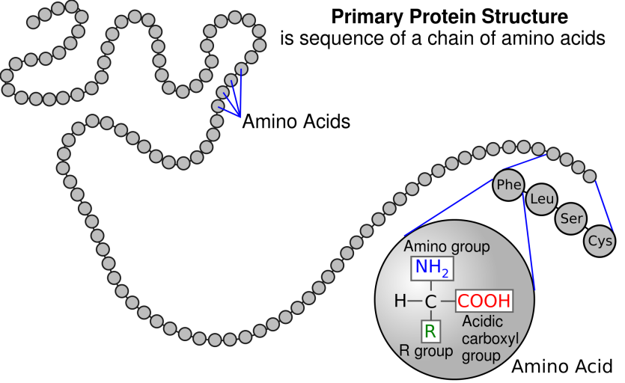
Primary Structure of Proteins
The primary structure of a protein is its amino acid sequence

Slide 5
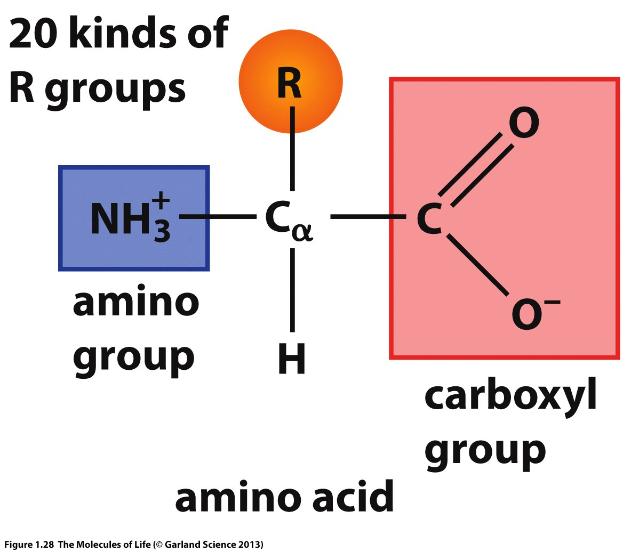
Amino acids: Building blocks of Proteins
Protein is a polymer of amino acids.
There are 20 common amino acids.
Amino acids have a common chemical structure - A tetrahedral sp³ carbon (C_{α}) with four different functional groups:
Amino group
Carboxyl group
H-atom
Side chain (R) with distinct chemical property

Slide 6
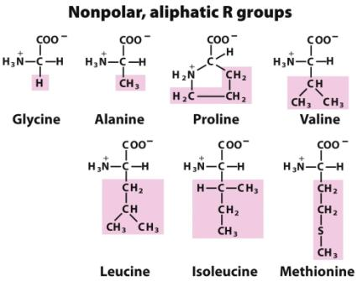
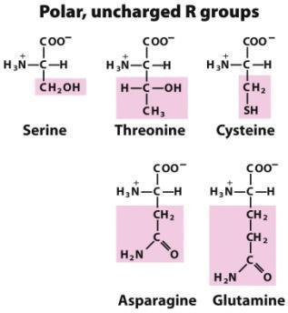
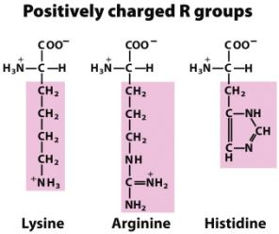
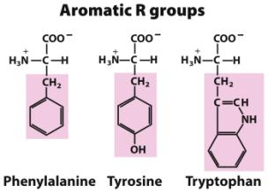
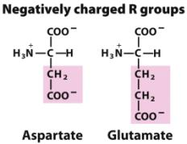
The 20 Common Amino Acids of Proteins

Slide 7
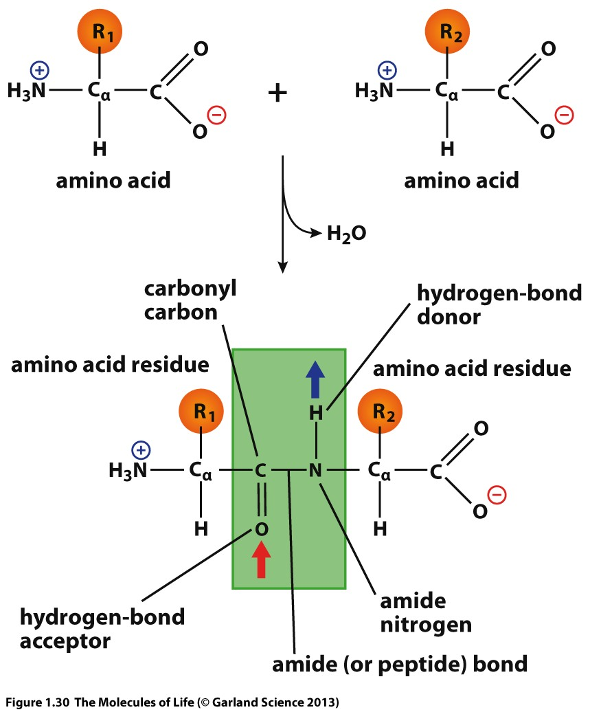
Formation of the peptide bond

Slide 8
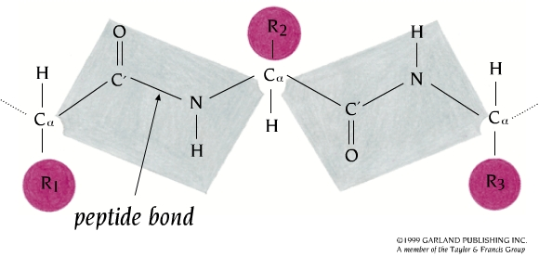
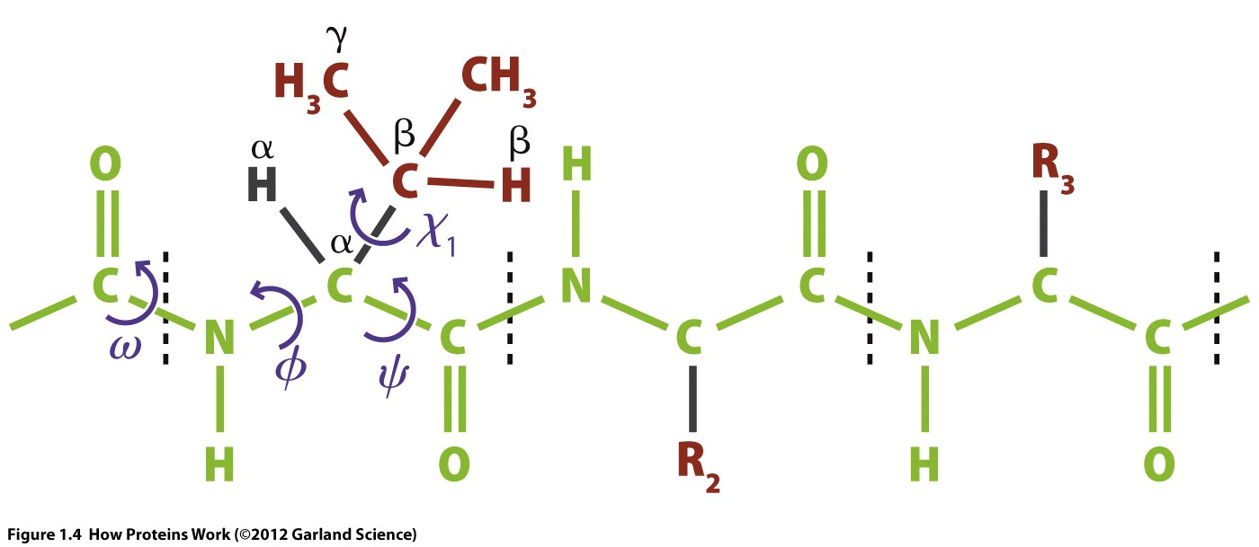
Torsion angles: Φ (phi) and Ψ (psi)
Peptide Plane
Notes:
Due to the planar nature of the peptide group, a polypeptide chain can be seen to have a backbone that consists of a series of rigid planar peptide groups linked by the C_{α} atoms. Though rotation is not permitted about the peptide bonds, rotation can happen around the C_{α}–N and C_{α}–C bonds. The angles of rotation, termed torsion angles , about these bonds specify the conformation of a polypeptide backbone. The torsion angles about the C_{α}–N and C_{α}–C bonds are referred to as ɸ (phi) and ψ. (psi), respectively.

Slide 9
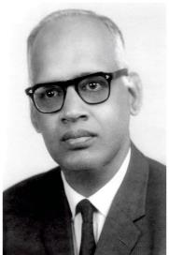
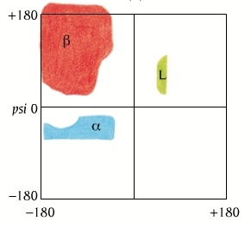
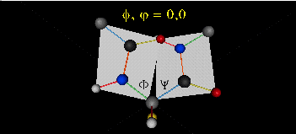
Ramachandran Plot
G. N. Ramachandran
Φ
Ψ
ω
Ψ (psi)
Φ (phi)
Notes:
Steric constraints apply to ɸ and ψ. As a result of which, only certain values of ɸ and ψ are permitted whilst others are not; hence only certain conformations of the peptides are possible. It is possible to calculate these permitted values for a given residue in the context of a polypeptide. A conformational plot of ɸ against ψ for a particular residue is known as a Ramachandran plot (after its inventor, G. N. Ramachandran). This plot allows us to identify those conformations (i.e. for a particular value of ɸ and ψ) that are sterically favourable or unfavourable.

Slide 10
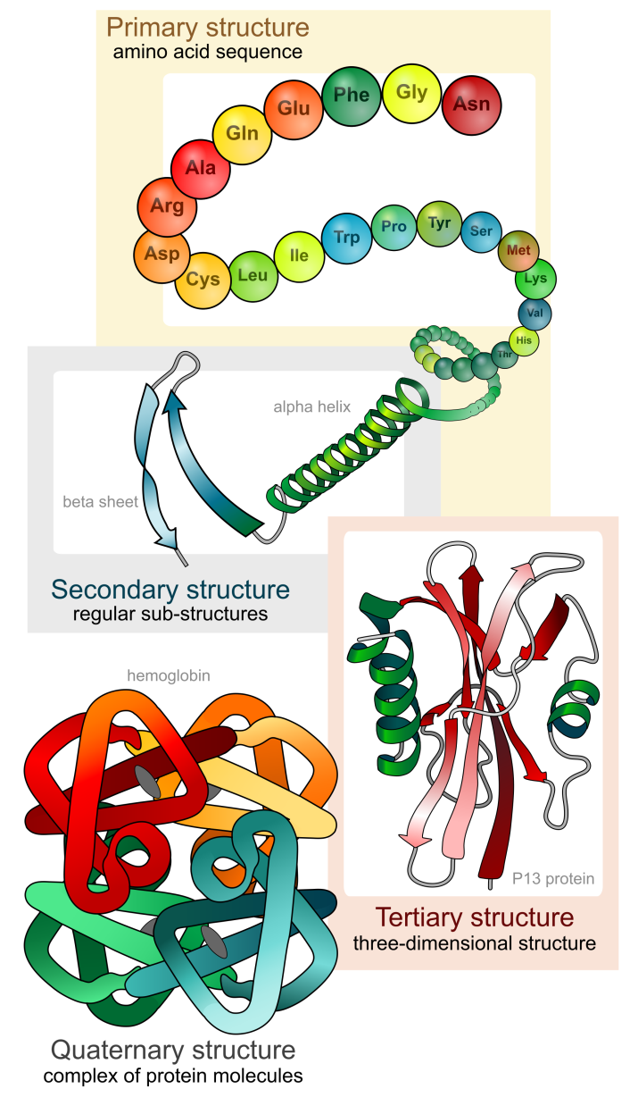
Protein Molecules are Organized in a Structural Hierarchy
Primary
Secondary
Tertiary
Quaternary

Slide 11
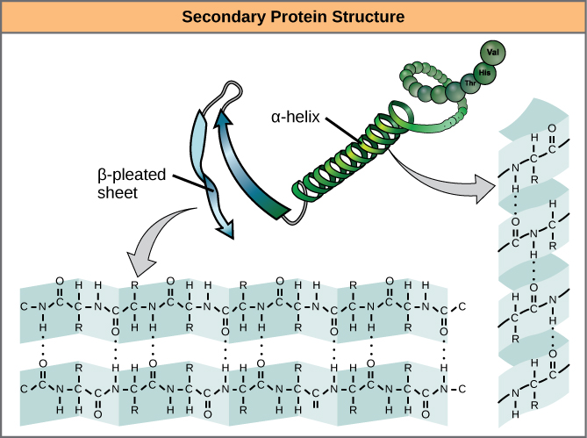
Secondary Protein Structure
Characterized by main chain NH and CO groups participating in H-bonds
Beta Sheet
Alpha helix

Slide 12
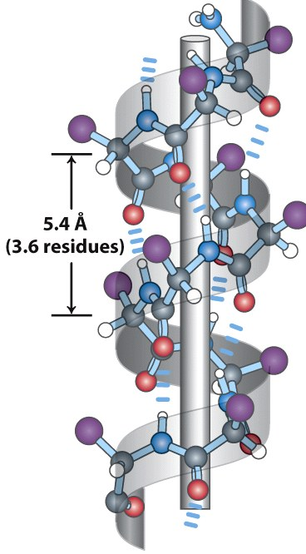
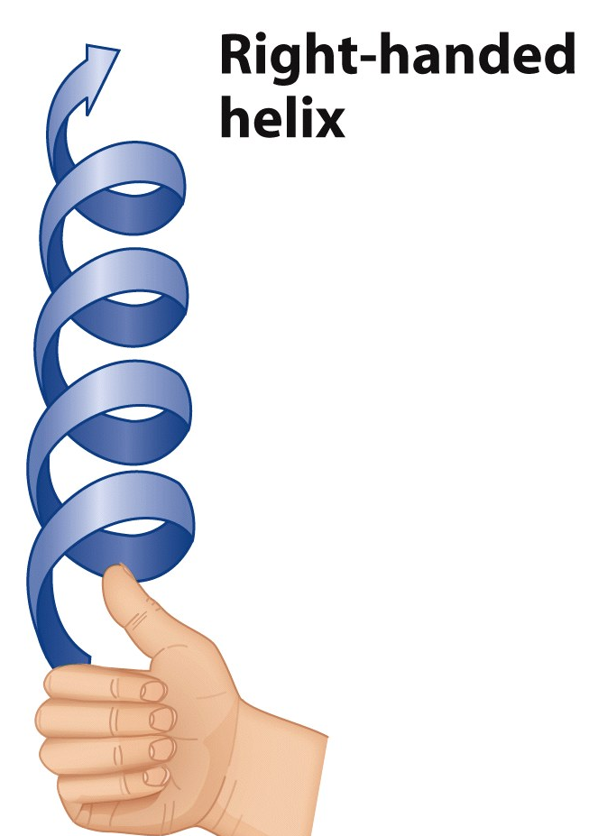
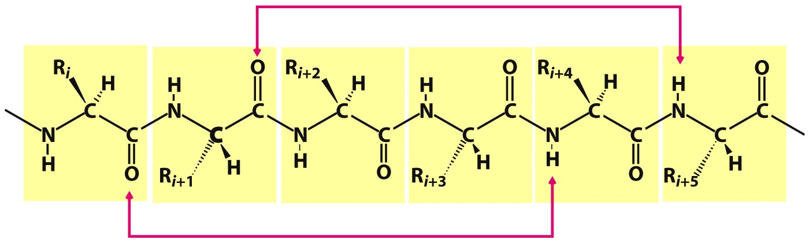
Alpha Helix
Every 3.6 residues make one turn
The distance (pitch of helix) between two turns is 5.4 Å
The C=O of residue ‘n’ is hydrogen bonded to N-H of residue ‘n+4’
n n+1 n+2 n+3 n+4 n+5
Notes:
FIGURE 4-4 Models of the α helix, showing different aspects of its structure. (a) Ball-and-stick model showing the intrachain hydrogen bonds. The repeat unit is a single turn of the helix, 3.6 residues. (b) The α helix viewed from one end, looking down the longitudinal axis (derived from PDB ID 4TNC). Note the positions of the R groups, represented by purple spheres. This ball-and-stick model, which emphasizes the helical arrangement, gives the false impression that the helix is hollow, because the balls do not represent the van der Waals radii of the individual atoms. (c) As this space-filling model shows, the atoms in the center of the α helix are in very close contact. (d) Helical wheel projection of an α helix. This representation can be colored to identify surfaces with particular properties. The yellow residues, for example, could be hydrophobic and conform to an interface between the helix shown here and another part of the same or another polypeptide. The red and blue residues illustrate the potential for interaction of negatively and positively charged side chains separated by two residues in the helix.

Slide 13
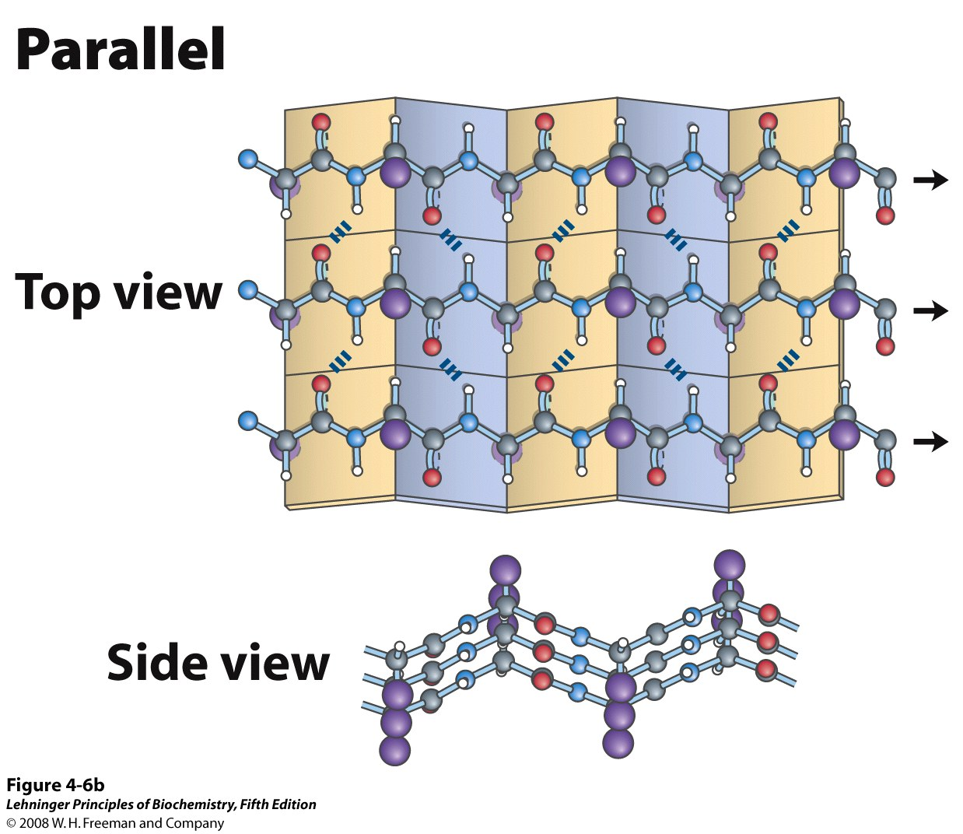
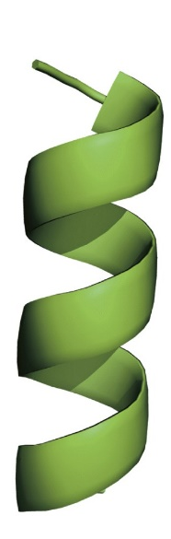
β-sheet
(Number of β-Strands are Involved)
β-sheet from several regions of the chain; Each β-strand, typically 5-10 residues long
α-helix: from one continuous region
H-bonds are perpendicular to strands
Notes:
The β conformation of polypeptide chains. These top and side views reveal the R groups extending out from the β sheet and emphasize the pleated shape described by the planes of the peptide bonds. (An alternative name for this structure is β-pleated sheet.) Hydrogen-bond cross-links between adjacent chains are also shown. The amino-terminal to carboxyl-terminal orientations of adjacent chains (arrows) can be the same or opposite, forming (a) an antiparallel β sheet or (b) a parallel β sheet.

Slide 14
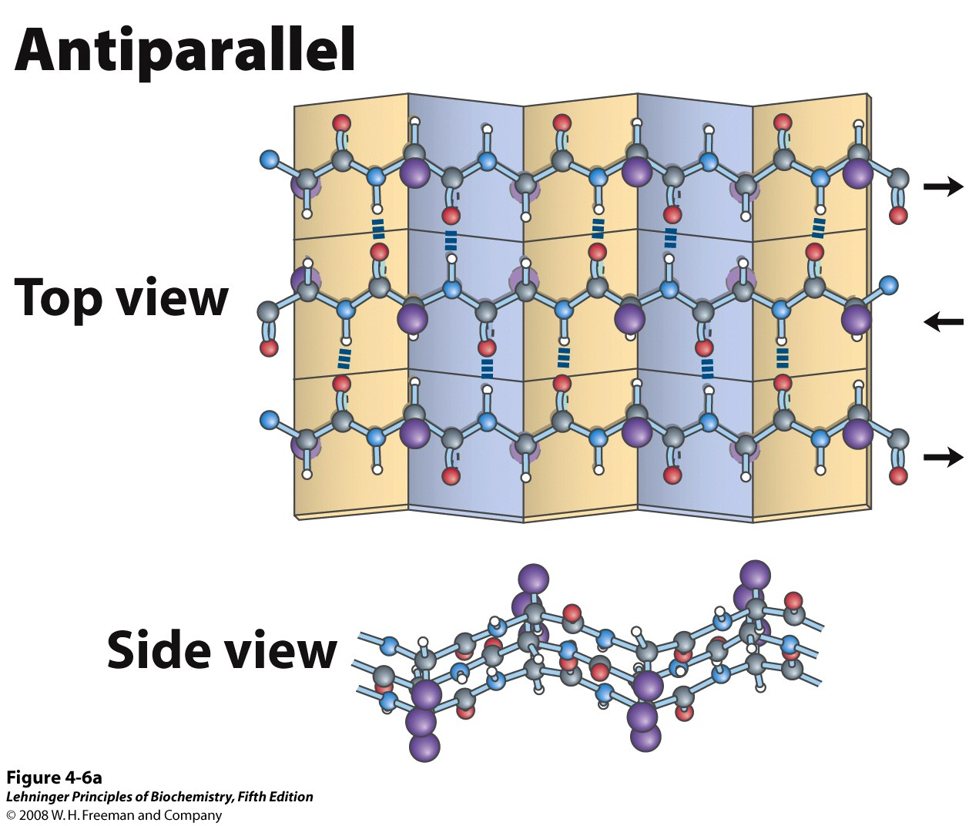
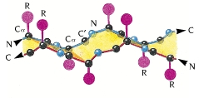
Parallel and Antiparallel β-sheet
β-pleated sheet: ‘pleated’ because side chains point up and down alternatively

Slide 15
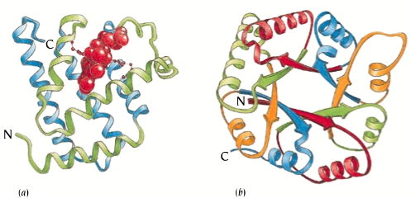
Polypeptide Chains Fold into Several Domains
Fundamental unit of tertiary structure – DOMAIN
Domain: polypeptide chain or a part of polypeptide chain that can independently fold into a stable tertiary structure
Domains are also units of function
Tertiary structure refers to the spatial arrangement of amino acid residues that are far apart in the sequence and to the pattern of disulfide bonds.

Slide 16
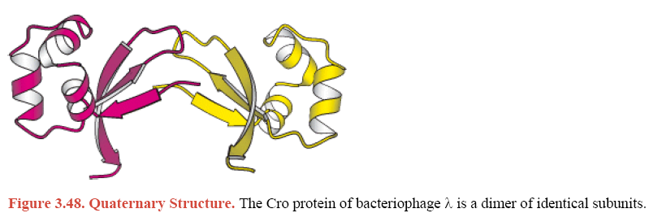
Quaternary Structure
Proteins containing more than one polypeptide chain exhibit a fourth level of structural organization. Each polypeptide chain in such a protein is called a subunit.
Quaternary structure refers to the spatial arrangement of subunits and the nature of their interactions.
The simplest quaternary structure is a dimer, consisting of two identical subunits.

Slide 17
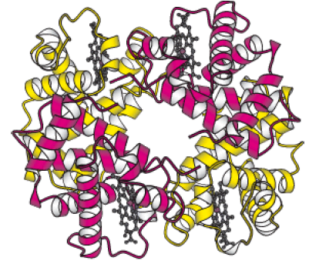
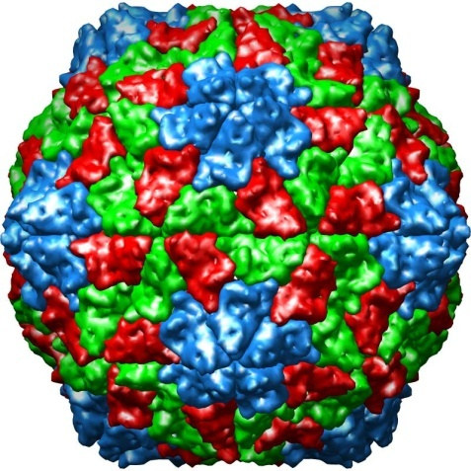
Quaternary Structure (higher order)
The α2β2 tetramer of human haemoglobin. The structure of the two identical α subunits (red) is similar to but not identical with that of the two β subunits (yellow).
Complex Quaternary Structure. The coat of rhinovirus comprises 60 copies of each subunits

Slide 18
The Protein Folding Problem

Slide 19
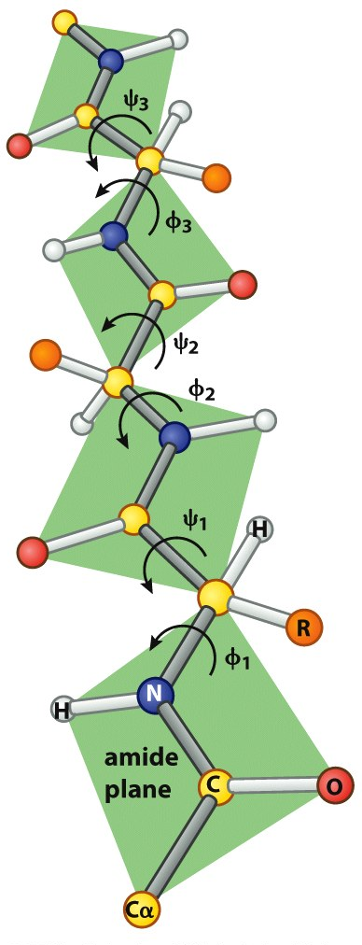
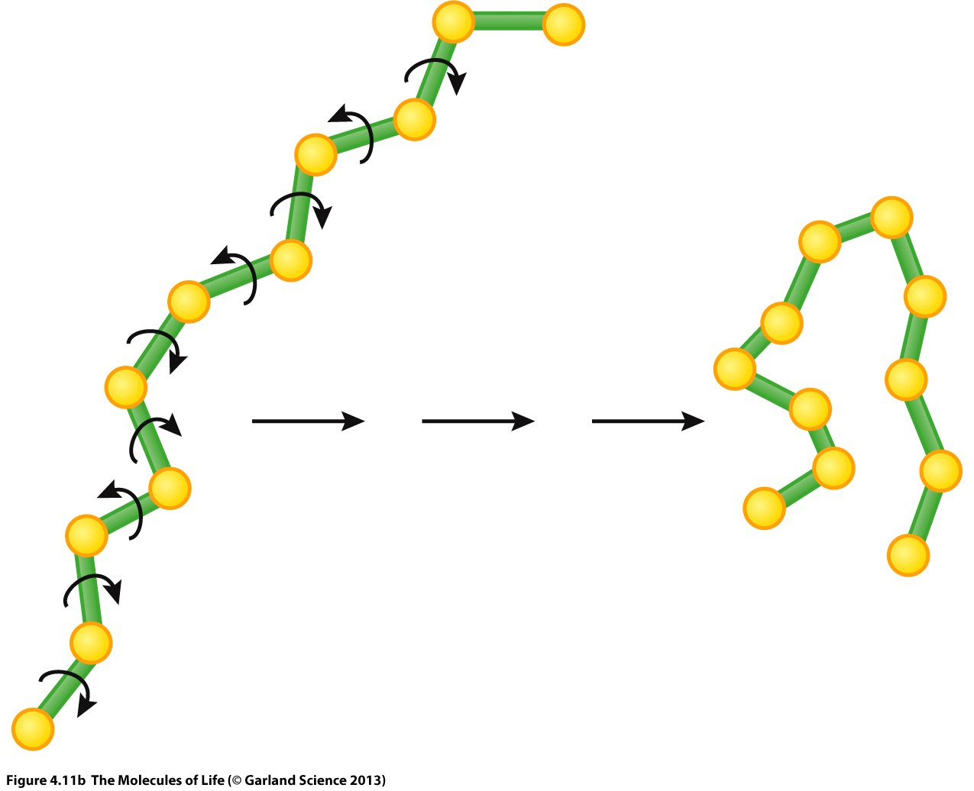
φ and ψ torsion angles are the only degrees of freedom for the backbone
3
2
1

Slide 20
The protein folding paradox
Consider a small protein with 100 residues.
Cyrus Levinthal calculated that, if each residue can assume three different conformations, the total number of structures would be 3¹⁰⁰, which is equal to 5 × 10⁴⁷. If it takes 10⁻¹³ s to convert one structure into another, the total search time would be 5 × 10⁴⁷ × 10⁻¹³ s, which is equal to 5 × 10³⁴ s, or 10²⁷ years i.e. longer than the age of the universe!
Clearly, it would take much too long for even a small protein to fold properly by randomly trying out all possible conformations.
The enormous difference between calculated and actual folding times is called Levinthal's paradox.

Slide 21
The 3D structure of a protein is encoded in its primary sequence
Protein folding: a set of ordered pathways by which 1D amino acid sequence of a protein folds into its native functional 3D conformation.
Thermodynamic hypothesis of Protein Folding: The interactions between the atoms in a protein control the folding of the protein molecule into a well-defined three-dimensional structure.
In 1950s Christian Anfinsen showed that the amino acid sequence contains enough information required for the proper folding of the protein into its functional three-dimensional structure.

Slide 22
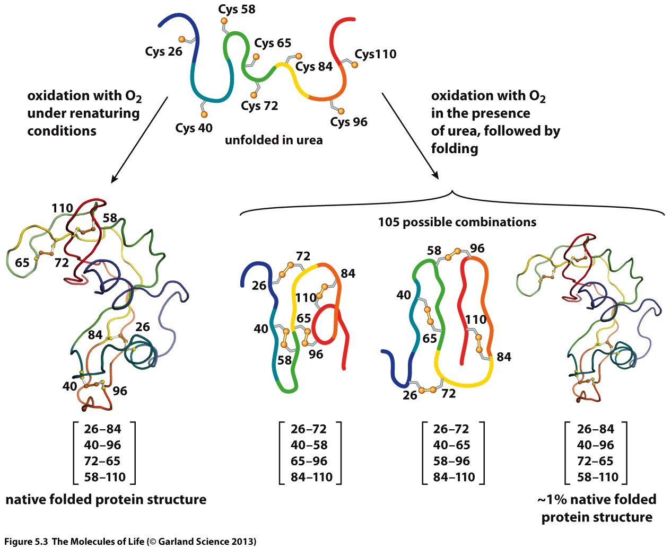
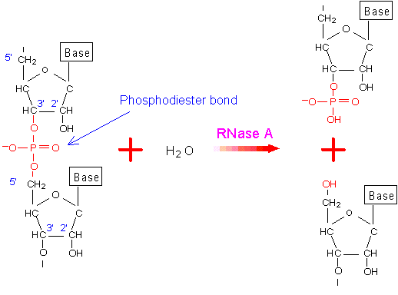
Anfinsen’s Experiment
Ribonuclease A (RNase A) enzyme was used for the experiment
RNase catalyses breakdown of RNA molecules:
Catalytic Function is a readout of its 3D conformation
124 aa long, with 4 disulphide bonds
Anfinsen treated RNase with:
Urea: disrupts all non-covalent bonds (H-bonds, ionic bonds etc.), leading to unfolding of RNase
BME (β-mercapto ethanol): breaks all S-S (disulfide) bonds
RNase A

Slide 23
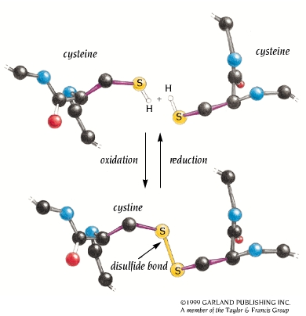
Disulfide bond forms between two cysteine residues by reaction between the sulfhydryl (SH) side chains

Slide 24
Anfinsen’s Experiment
1.
BME (β mercapto ethanol) treatment breaks all S-S bonds

Slide 25
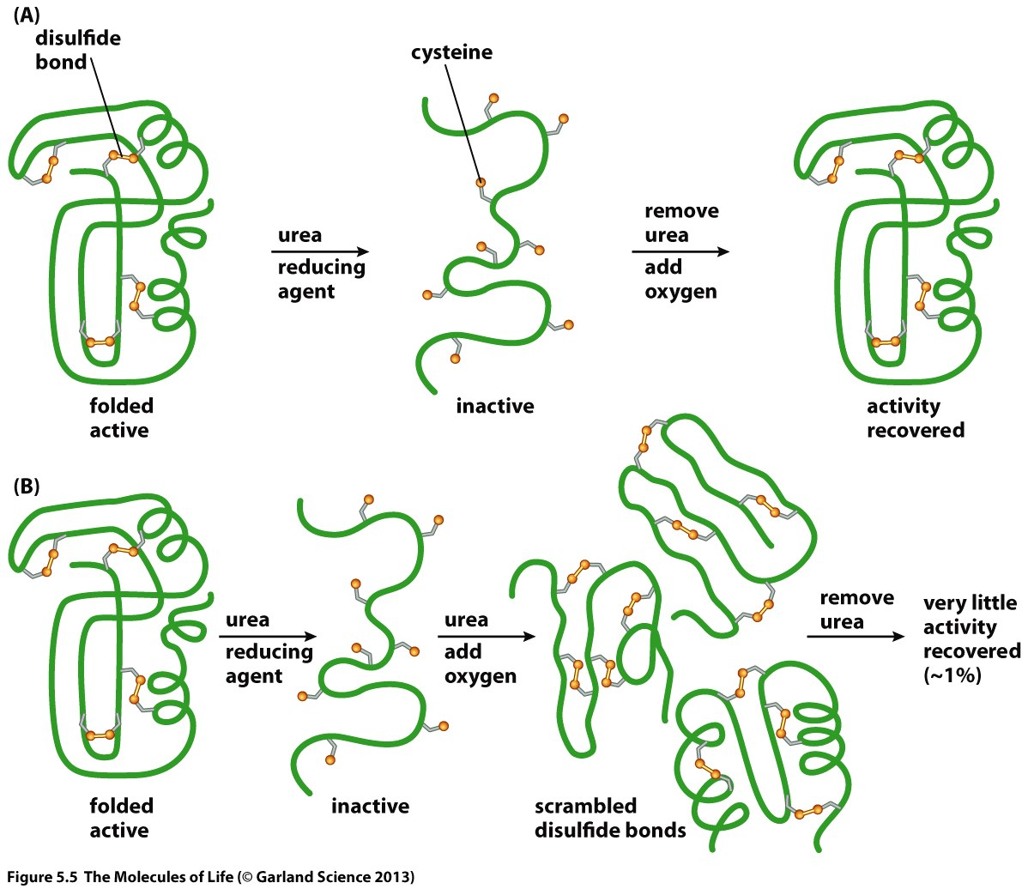
Anfinsen’s Experiment
If we understand HOW PROTEINS FOLD, we can predict their structure from sequence! Then we can design proteins with novel functions.

Slide 26
8 Cys
Select two at a time to form a disulphide bond
⁸C₂ * ⁶C₂ * ⁴C₂ * ²C₂ / 4! = 2520/4! = 105
# of ways to choose the first disulfide bond
It does not matter in which order the FOUR disulphide bonds are formed. # of permutations of FOUR disulfide bonds.

Slide 27
Forces that stabilize a protein structure
Hydrophobic effect
Conformational entropy
Electrostatics
Hydrogen bonding
van der Waals interaction
Most important feature: The interior of proteins is hydrophobic!
The main driving force for folding water soluble globular protein molecules is to pack hydrophobic side chains into the interior of the molecule, thus creating a HYDROPHOBIC CORE and a HYDROPHILLIC SURFACE.
Problem: How to create such a hydrophobic core from a linear protein chain ???

Slide 28
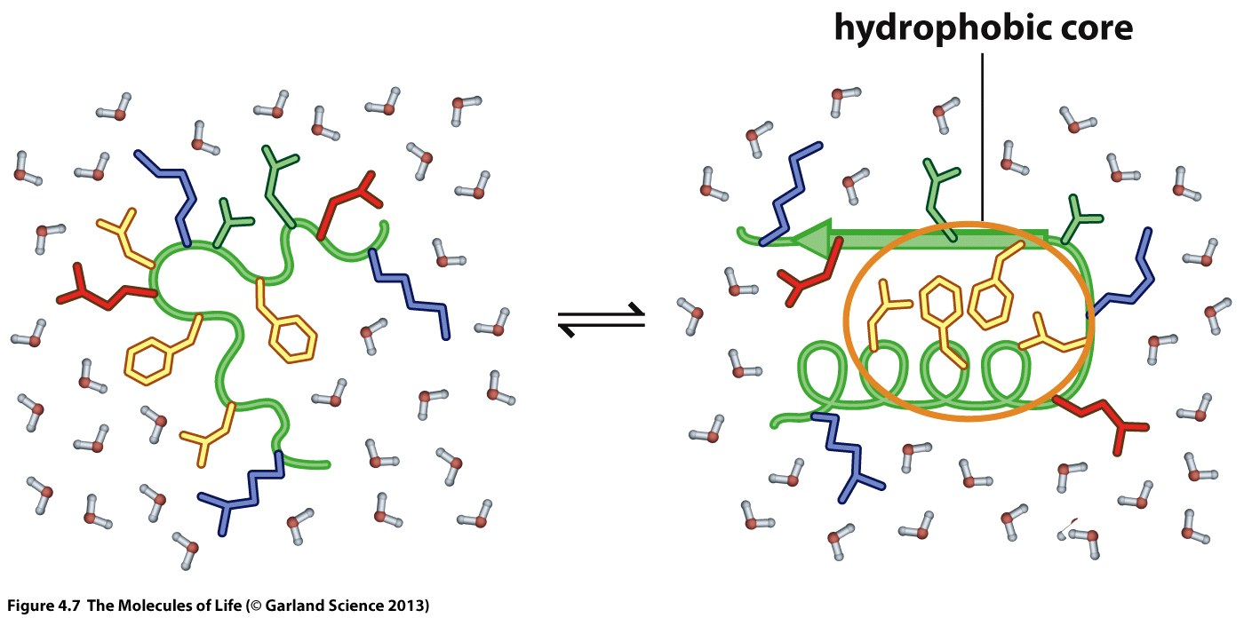
Hydrophobic core formation drives protein folding

Slide 29

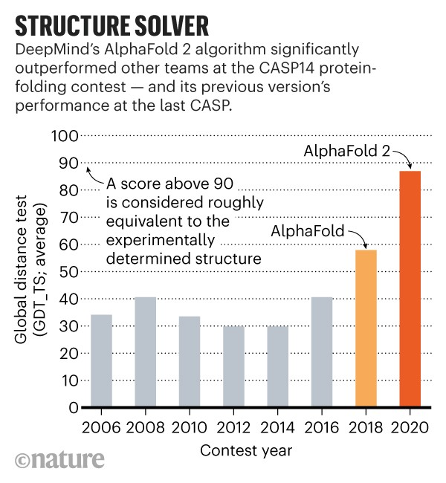
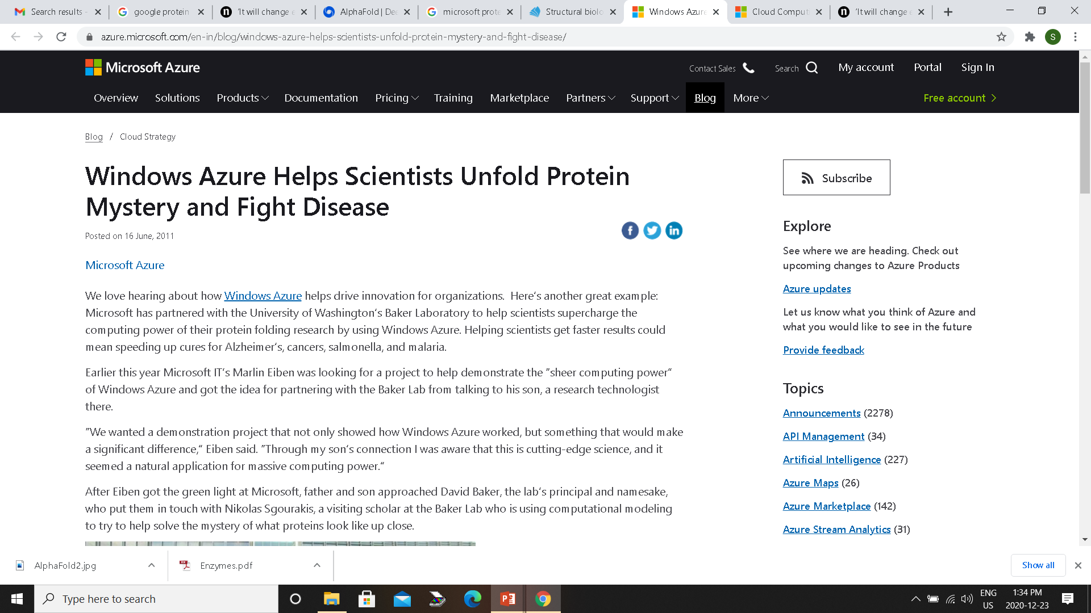
Can we predict protein structure from sequence
Anfinsen’s experiment demonstrates that a protein sequence encodes its structure.
Can we decipher this code? I.e. can we predict the structure of a protein from its primary sequence?
Prediction
Sequence
Structure

Slide 30
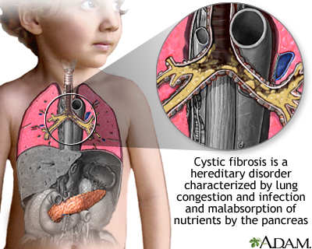
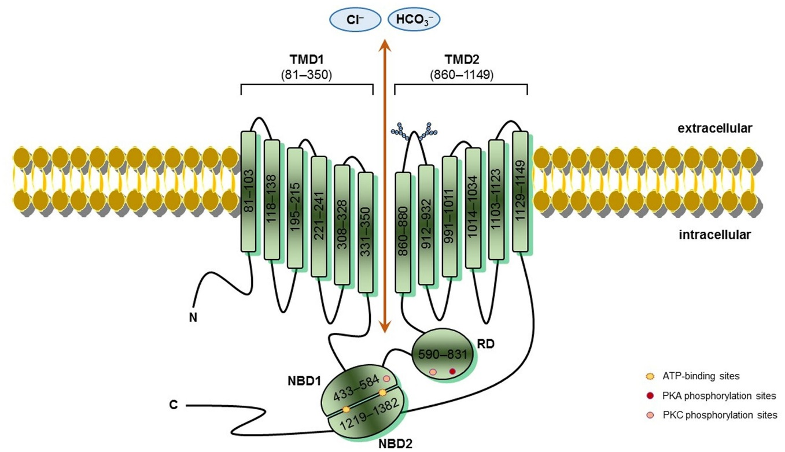
Protein misfolding leads to several diseases
Several diseases occur due to misfolding of proteins. Few examples:
Cystic Fibrosis: It results from the misfolding of Cystic Fibrosis Transmembrane Conductance Regulator (CFTR), a protein functioning as a chloride (Cl⁻) ion channel. The loss of CFTR function interferes with the body’s ability to efficiently secrete fluids and salts. It damages the lungs and digestive systems.
https://medlineplus.gov/ency/article/000107.htm
Frontiers in Pharmacology 2016 v-7, p-275

Slide 31
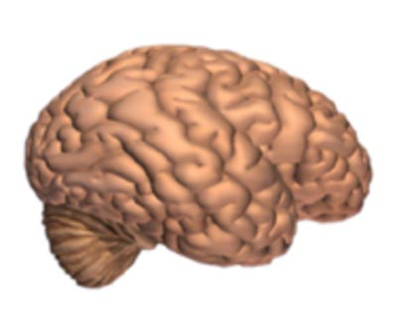
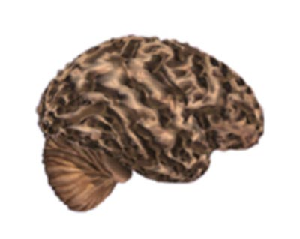

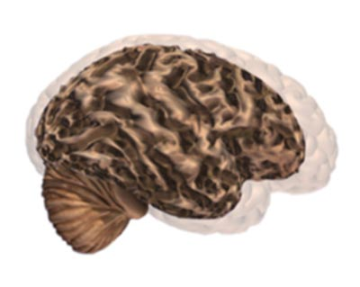
Protein misfolding leads to several diseases
Several diseases occur due to misfolding of proteins. Few examples:
Alzheimer’s Disease (AD): It results from the aggregation and precipitation of a peptide called amyloid-β (Aβ). AD is the most common form of progressive dementia in the elderly, and of neuro-degenerative diseases in general.
Normal Brain
Brain with AD
Comparison of the two Brains
www.alz.org

Slide 32
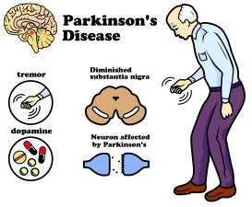

Protein misfolding leads to several diseases
Several diseases occur due to misfolding of proteins. Few examples:
Parkinson’s Disease (PD): It results from aggregation and precipitation of the protein α-synuclein. PD is a motor disorder common among the elderly (but can also hurt young people). It leads to shaking, stiffness, and difficulty with walking, balance, and coordination.
http://www.askdrray.com/parkinsons-disease-may-stopped/
Lancet Neurol 2018; 17: 939–53

Slide 33
Thank You

